Slide 1

OGC ISG Year 2 Sprint Kickoff :
Jordan Dauble – Owner
Glen Johnson – Principal Software Developer
Danie Conradie – Principal Software Developer
Notes:
Couple seconds: mention names of organization and primary contacts

Slide 2
Video Demo (~90 Seconds)
Austin in Unity
Paris in Unity
Austin in Unreal
San Diego in Unreal

Slide 3
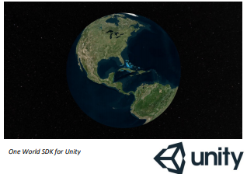
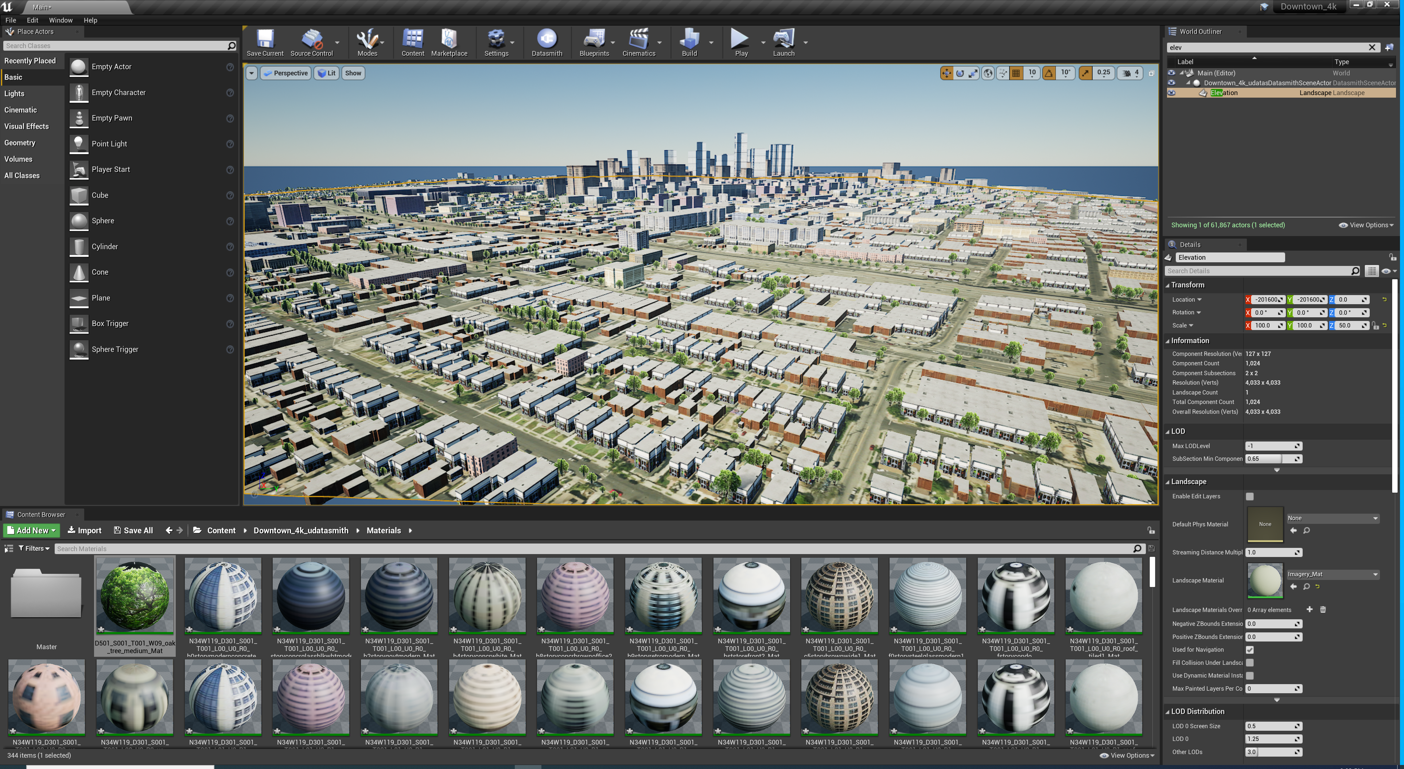
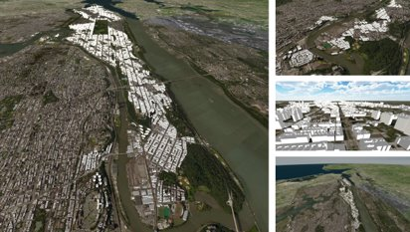


SimBlocks.io Vision
Core Capabilities
Software Development
Game Engine Development
Virtual Reality, Augmented Reality, Mixed Reality (VR, AR, MR)
Live, Virtual, Constructive, Gaming (LVC&G) interoperability solutions
Vision
Leverage commercial game engines to simulate a digital twin of the real world.
Standards Experience
OpenFlight
CDB
GeoVolumes
3D Tiles
glTF
GeoPackage
CDB SDK
3D Tiles SDK

Slide 4
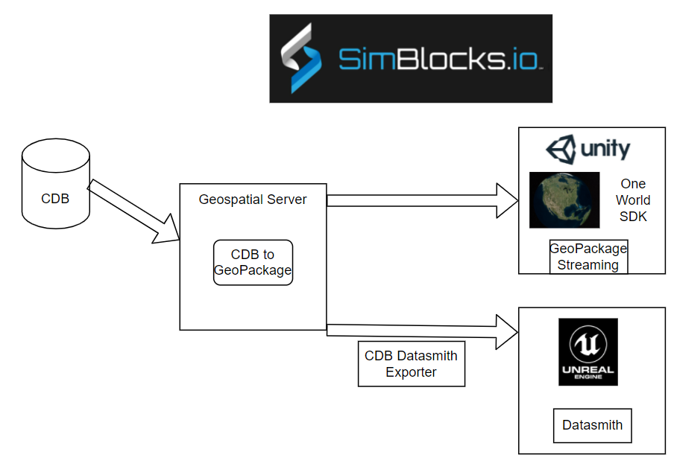
Architecture Diagram

Slide 5
High-Level Summary of Scenario 1
Scenario 1B - Conversion
Batch conversion of CDB to GeoPackage
Convert OpenFlight models to glTF binary encodings stored in GeoPackage.
Define an xml structure to allow varying packaging of the GeoPackage output
from the CDB. (tiling structure, layer content, model formats)
San Diego CDB will at least be supported in this effort. Others?
Scenario 1B - Visualization
Visualize terrains in Unity and Unreal game engines.
Integrate with Unity by loading GeoPackage on top of the One World SDK for Unity to enable visualizing geospecific 3D content with a world-wide base terrain
Integrate with Unreal using SimBlocks.io CDB Runtime Publisher SDK for Unreal

Slide 6
High Level Summary of Scenario 3
Scenario 3
Leverage a procedural city generation capability that SimBlocks has developed to quick create 3D content from source data including imagery, elevation, and building footprints.
Current generation tool has focused on geotypical and geospecific 3D buildings.
Scenario 3 – Transportation
Add transportation elements procedurally to this database using additional openly available and sharable data sources, which will then be added to the GeoPackage.
Enhance the tool to support traffic simulation on roads and rails.
Integrate historical flight information to show an aircraft flying over the city.

Slide 7
Accomplishments – Part 1
Description(s) of your accomplishments during the sprints
Conversion of CDB content into GeoPackage keeping OpenFlight Models
Conversion of CDB content into GeoPackage using GLTF binary as model format
3d content creation directly into GeoPackage using GLTF binary as the model format
Capture performance metric of format choices using osg software
GeoPackage playback using the Unity Game Engine
GeoPackage content conversion into Unreal Engine
Did you accomplish what you intended
We accomplished much of but not all of our planed goals.
Texture flickering, mipmap issues.
Showing transportation elements is still an outstanding task.

Slide 8
Accomplishments – Part 2
Did you reach any stretch goals
No
Did you accomplish something unintended but necessary or interesting
Our team now has a much better understanding of glTF.
utilized Unity’s “Advanced” Mesh API for better runtime performance
Major software upgrade to improve support for CDB and GeoPackage in Unity.
Learned new and better ways to interoperate between C++ and C#
Any cooperative work with any other participants

Slide 9
Challenges (1-3 minutes)
What were the challenges you encountered
Issues with GLTF creation in the osg software we were using for conversion
Tile content issues in the San Diego CDB
Tile Model Geometry limits exceeded
Tile Model Reference counts exceeded
Unfortunately Unity does not allow loading Managed C++ modules. We had to manually wrap C++ and C# code for interoperability.
Bug in Unity: When a Plugin loads an external DLL, Unity will enter into an unstable state, making the Editor unusable. A workaround was to build the standalone player, which makes debugging more difficult.
Gaps in specifications or technical capabilities
The unexpected issues encountered in creating GLTF could be considered and gap in technical capabilities.
This gap was address by correcting the issues and publishing the updates.

Slide 10
Recommendations (1-3 minutes)
What might you recommend for consideration in a future sprint, scenario, or stand-alone initiative
This could be informed by your accomplishments, challenges, stretch goals, or knowledge of the space, etc.
Reduce GeoPackage size by sharing textures between models
Reduce GeoPackage size and loading time by using DXT/hardware texture compression
-Improve Unity rendering performance by batching models and sharing materials and textures

Slide 11
Closing Remarks (1-5 minutes)
Additional thoughts and Q&A
Any key takeaways that were not identified in the prior slides
Open the floor to Q&A regarding for your scenario(s)

Slide 12







The end.
Building Blocks for High Fidelity Simulations
THANK YOU!
Jordan Dauble, Owner
Jordan.Dauble@SimBlocks.io
Glen Johnson, Principal Software Developer
Glen.Johnson@SimBlocks.io
Danie Conradie, Principal Software Developer
Danie.Conradie@SimBlocks.io

